Slide 1
Introduction to Map Functions Part 1

Slide 2
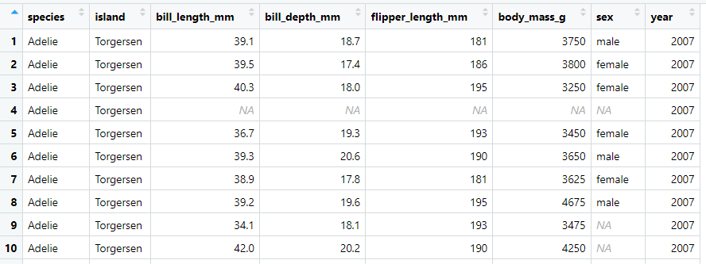
Data

Slide 3
Nesting
nest(): is a function used to group data into a nested structure.

Slide 4
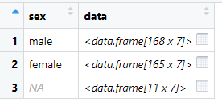
Example 1: Nest the penguins dataset by sex
example_1 <- penguins %>%
group_by(sex) %>%
nest()
Output:

Slide 5
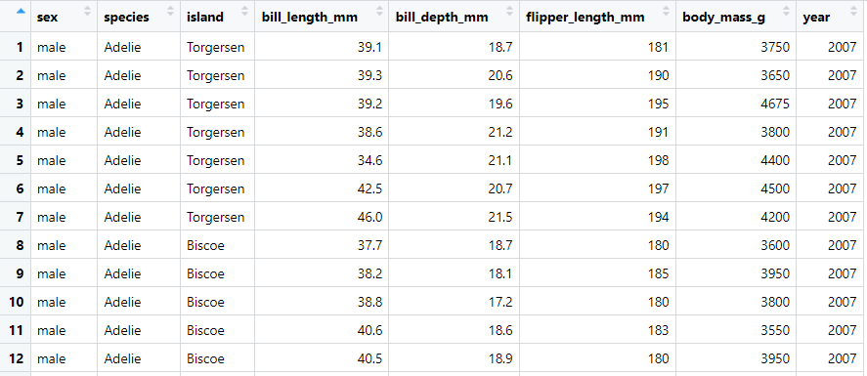
Example 2: Unnest the dataset you created in Example 1.
example_2 <- example_1 %>%
unnest(cols = c(data))
Output:

Slide 6
Pull
pull(): is a function that works like $. It calls a specific column of your dataframe.

Slide 7
Example 3: Consider the frequency table for species:
table(penguins$species)
Adelie Chinstrap Gentoo
152 68 124
Make the same table using pull:

Slide 8
Map
The map() function is a powerful tool in the tidyverse package that allows you to apply a function to each element of a list or vector, and then returns a list containing the results. It's particularly useful when you have repetitive tasks to perform on multiple elements. This function is part of the purrr package within the tidyverse.

Slide 9
Example 4: Use the function you created with the values (without map)
square <- function(x) {
y<-x^2
return(y)
}
values <- c(2, 4, 6, 8)
example_4 <- square(values)
example_4
Output:

Slide 10
Example 5: Use map to apply the function to each element
Note: The result is a list with squared values. To get results back to a vector unlist()
example_5 <- map(values, square)
final_results <- unlist(example_5)
final_results
Output:

Slide 11
Combining Nesting and Mapping

Slide 12
Example 6: Combine nest() with map(), and compute the mean of bill_length_mm, the mean of body_mass_g, and the mean of bill_depth_mm for each value of the sex type.
example_6 <- penguins %>%
group_by(sex) %>%
nest() %>%
mutate(mean_bill_length = map(data, ~ mean(pull(.x, bill_length_mm), na.rm = TRUE)),
mean_body_mass = map(data, ~ mean(pull(.x, body_mass_g), na.rm = TRUE)),
mean_bill_depth = map(data, ~ mean(pull(.x, bill_depth_mm), na.rm = TRUE)))

Slide 13
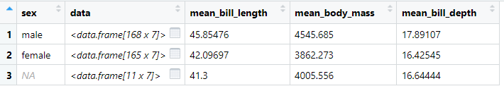
Output:

